Slide 1
LINKED LIST

Slide 2
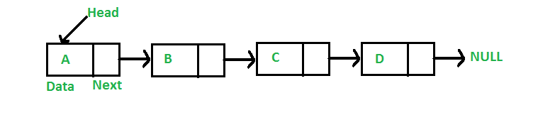
WHAT IS LINKED LIST
A linked list is a linear data structure, in which the elements are not stored at contiguous memory locations. The elements in a linked list are linked using pointers as shown in the below image:
In simple words, a linked list consists of nodes where each node contains a data field and a reference(link) to the next node in the list.

Slide 3
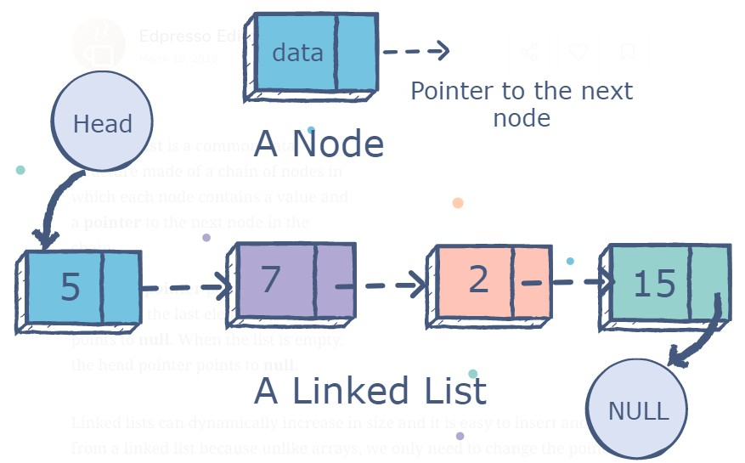
A linked list is a common data structure made of a chain of nodes in which each node contains a value and a pointer to the next node in the chain.
The head pointer points to the first node, and the last element of the list points to null. When the list is empty, the head pointer points to null.
Following are the important terms to understand the
concept of Linked List.
Link − Each link of a linked list can store a data called an element.
Next − Each link of a linked list contains a link to the next link called Next.
Linked List − A Linked List contains the connection link to the first link called First.

Slide 4
LINKED LIST V/S ARRAY
ARRAY | LINKED LIST
Array is a collection of elements of similar data type. | Linked List is an ordered collection of elements of same type, which are connected to each other using pointers.
Array supports Random Access, which means elements. Hence, accessing elements in an array is fast with a constant time complexity of O(1). | Linked List supports Sequential Access. To access nth element of a linked list, time complexity is O(n).
In an array, elements are stored in contiguous memory location or consecutive manner in the memory. | In a linked list, new elements can be stored anywhere in the memory.

Slide 5
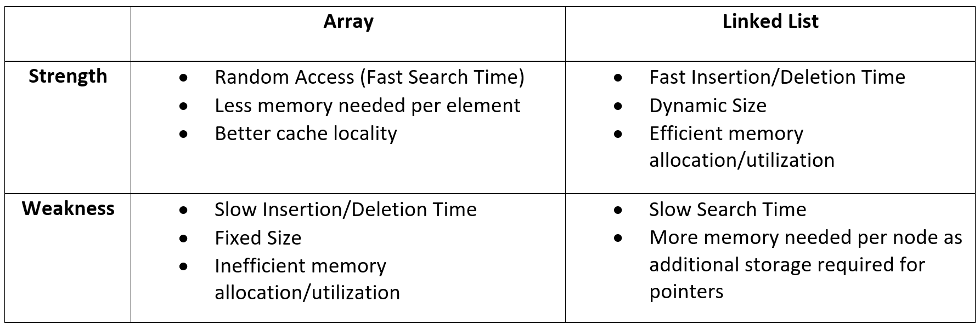
LINKED LIST V/S ARRAY

Slide 6
Poll question
An array elements are always stored in__ memory
Random
Sequential and Random
None of the above

Slide 7
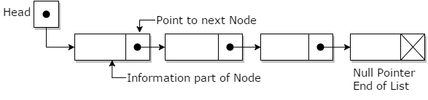
LINKED LIST
Each node is separated into two different parts:
The first part holds the information of the element or node
The second piece contains the address of the next node (link / next-pointer field) in this structure list.

Slide 8
LINKED LIST
In the data structure, you will be implementing the linked lists which always maintain head and tail pointers for inserting values at either the head or tail of the list is a constant time operation.
As such, linked lists in data structure have some characteristics which are mentioned below:
Insertion is O(1)
Deletion is O(n)
Searching is O(n)

Slide 9
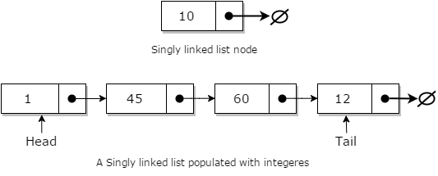
SINGLY LINKED LIST
Singly linked lists are one of the most primitive data structures. Here each node makes up a singly linked list and consists of a value and a reference to the next node (if any) in the list.

Slide 10
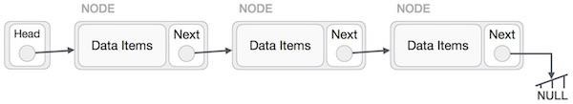
Linked List Representation
Linked list can be visualized as a chain of nodes, where every node points to the next node.
Linked List contains a link element called first.
Each link carries a data field(s) and a link field called next.
Each link is linked with its next link using its next link.
Last link carries a link as null to mark the end of the list.

Slide 11
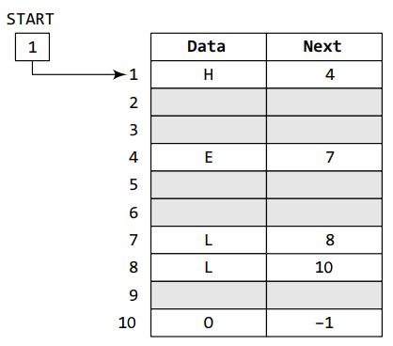
How A Linked List Is Maintained In The Memory ?
In order to form a linked list, we need a structure called
node which has two fields, DATA and NEXT.
DATA will store the information part and NEXT will store the address of the next node in sequence.
In the figure, we can see that the variable START is used to store the address of the first node.
Here, in this example, START = 1, so the first data is stored at address 1, which is H.
The corresponding NEXT stores the address of the next node, which is 4.
So, we will look at address 4 to fetch the next data item. The second data element obtained from address 4 is E.
Again, we see the corresponding NEXT to go to the next node. From the entry in the NEXT, we get the next address, that is 7, and fetch L as the data.
We repeat this procedure until we reach a position where the NEXT entry contains –1 or NULL, would denote the end of the linked list. When we traverse DATA and NEXT in this manner, we finally see that the linked list in the above example stores characters that when put together form the word HELLO.

Slide 12
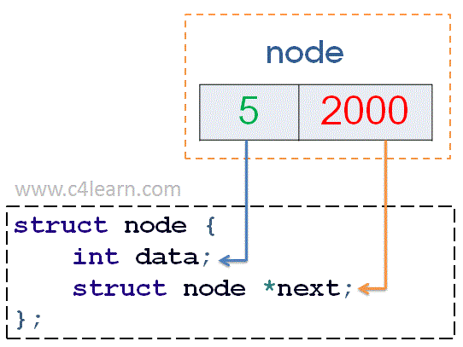
Singly linked list node structure
Explanation of Node Structure :
We have declared structure of type “NODE”, i.e we have created a Single Linked List Node.
A Node in general language is a Structure having two value containers i.e [Square box having two Partitions]
One value container stores actual data and another stores address of the another structure i.e (Square box having two partitions)
We have declared a structure and also created 1 very first structure called “Start”.
Very first node “Start” contain 1 field for storing data and another field for address of another structure
As this is very first node or Structure, we have specified its next field with “NULL” value.
struct node
{
int data;
struct node *next;
}
start = NULL;
In the above node structure we have defined two
fields in structure
Data :It is Integer Part for Storing data inside Linked List Node
Next: It is pointer field which stores the address of another structure (i.e node)

Slide 13
SINGLY LINKED LIST -INSERTION
In general, when people talk about insertion concerning linked lists of any form, they implicitly refer to the adding of a node to the tail of the list.
Adding a node to a singly linked list has only two cases:
head = fi, in which case the node we are adding is now both the head and tail of the list; or
we simply need to append our node onto the end of the list updating the tail reference appropriately

Slide 14
SINGLY LINKED LIST -INSERTION
// A linked list node
class Node
{ public:
int data;
Node *next;
};
A node can be added in three ways:
1) At the front of the linked list
2) After a given node.
3) At the end of the linked list.

Slide 15
SINGLY LINKED LIST -INSERTION
Add a node at the front: (A 4 steps process)
The new node is always added before the head of the given Linked List.
And newly added node becomes the new head of the Linked List.
For example if the given Linked List is 10->15->20->25 and we add an item 5 at the front, then the Linked List becomes 5->10->15->20->25.
Let us call the function that adds at the front of the list is push(). The push() must receive a pointer to the head pointer, because push must change the head pointer to point to the new node

Slide 16
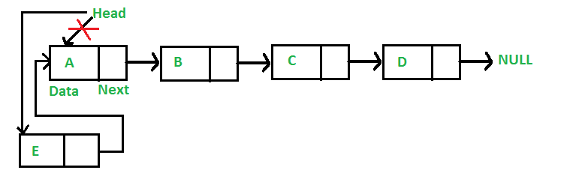
SINGLY LINKED LIST -INSERTION

Slide 17
SINGLY LINKED LIST -INSERTION
/* Given a reference (pointer to pointer) to the head of a list and an int, inserts a new node on the front of the list. */
void push(Node** head_ref, int new_data)
{
/* 1. allocate node */
Node* new_node = new Node();
/* 2. put in the data */
new_node->data = new_data;
/* 3. Make next of new node as head */
new_node->next = (*head_ref);
/* 4. move the head to point to the new node */
(*head_ref) = new_node;
}
https://www.tutorialspoint.com/cplusplus-program-to-implement-singly-linked-list

Slide 18
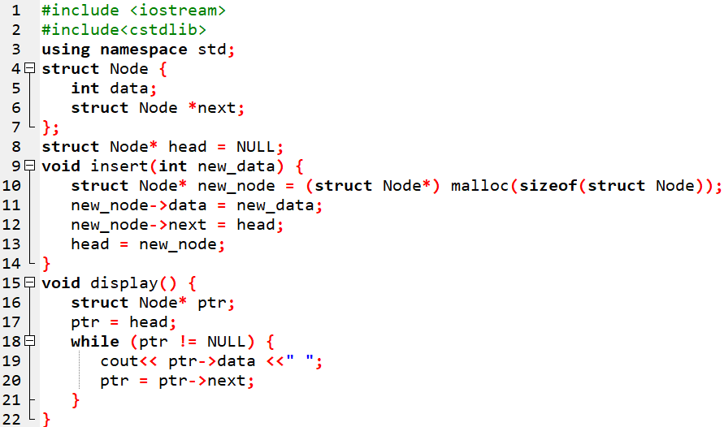
PROGRAM –INSERTION IN BEGINNING

Slide 19
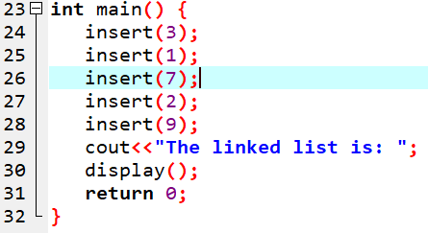
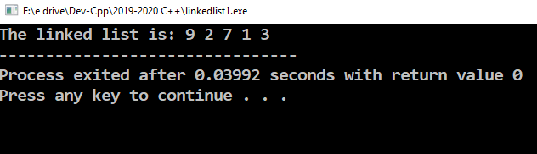
PROGRAM –INSERTION IN BEGINNING

Slide 20
PROGRAM –explanation
The function insert() inserts the data into the beginning of the linked list. It creates a new_node and inserts the number in the data field of the new_node. Then the new_node points to the head. Finally the head is the new_node i.e. the linked list starts from there.
The function display() displays the whole linked list. First ptr points to head. Then it is continuously forwarded to the next node until all the data values of the nodes are printed.
In the function main(), first various values are inserted into the linked list by calling insert(). Then the linked list is displayed

Slide 21
PROGRAM TO FIND SUM OF ALL NODES IN LINKED LIST
To find the sum of all elements of the singly linked list, we have to navigate to each node of the linked list and add the element's value to a sum variable. For example, Suppose we have a linked list: 2 -> 27 -> 32 -> 1 -> 5
sum = 2 + 27 + 32 + 1 + 5 = 67.
This can be done by using two methods :
Method 1 - Using a loop that loops over all the values of the linked list and finds the sum.
The loop runs till the end of the linked list i.e. when the pointer of an element points to null, this loop will run and find the sum of values of each element.

Slide 22
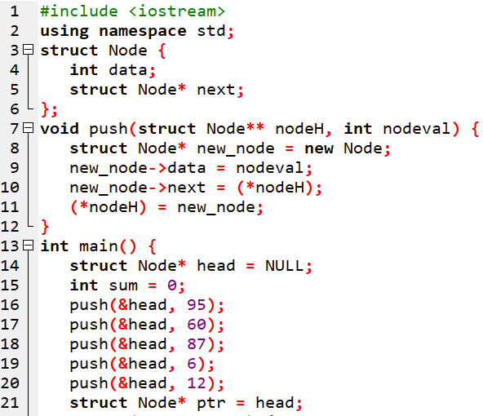
PROGRAM TO FIND SUM OF ALL NODES IN LINKED LIST

Slide 23
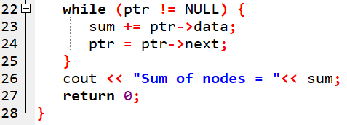
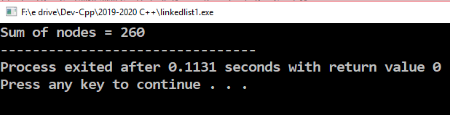
PROGRAM TO FIND SUM OF ALL NODES IN LINKED LIST

Slide 24
PROGRAM TO FIND SUM OF ALL NODES IN LINKED LIST
Method 2 - Using a recursive function that calls itself until the linked list has elements. The recursive function calls itself again and again. The call to the recursive function sends the next node values as a parameter along with the sum address location.

Slide 25
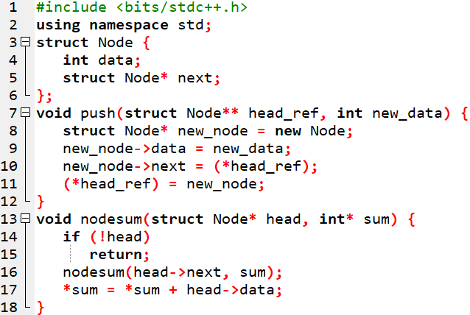
PROGRAM TO FIND SUM OF ALL NODES IN LINKED LIST
sum address location.

Slide 26
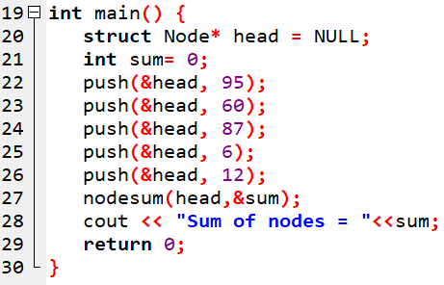
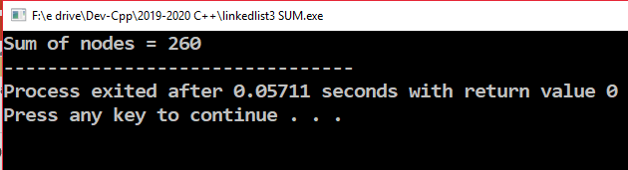
PROGRAM TO FIND SUM OF ALL NODES IN LINKED LIST

Slide 27
DOUBLY LINKED LIST
Doubly Linked List is a variation of Linked list in which navigation is possible in both ways, either forward and backward easily as compared to Single Linked List. Following are the important terms to understand the concept of doubly linked list.
Link − Each link of a linked list can store a data called an element.
Next − Each link of a linked list contains a link to the next link called Next.
Prev − Each link of a linked list contains a link to the previous link called Prev.

Slide 28
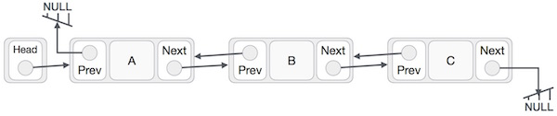
DOUBLY LINKED LIST
As per the above illustration, following are the important points to be considered.
Doubly Linked List contains a link element called first and last.
Each link carries a data field(s) and two link fields called next and prev.
Each link is linked with its next link using its next link.
Each link is linked with its previous link using its previous link.
The last link carries a link as null to mark the end of the list.

Slide 29
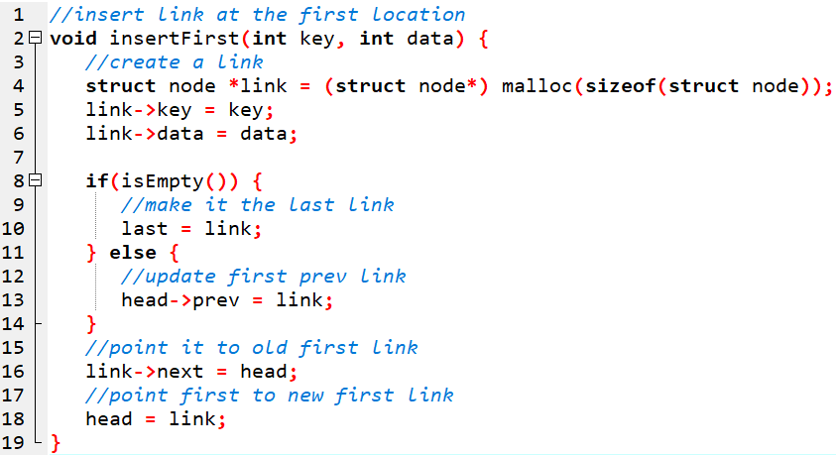
DOUBLY LINKED LIST-insertion

Slide 30
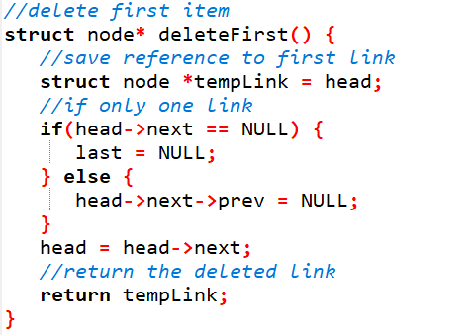
DOUBLY LINKED LIST-deletion

Slide 31
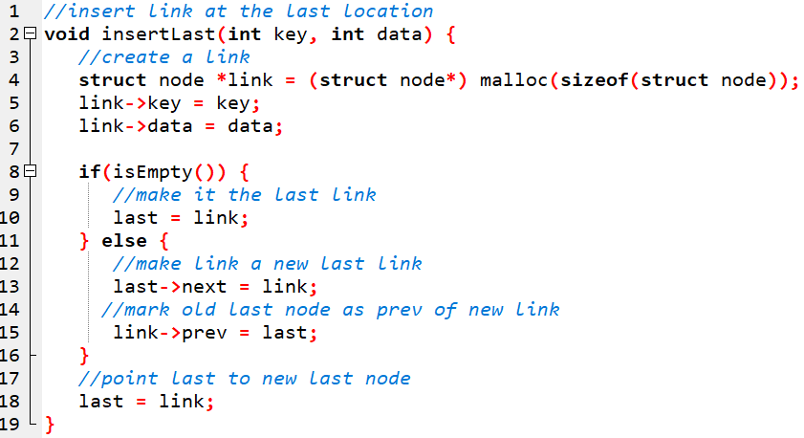
DOUBLY LINKED LIST-insertion at the end

Slide 32
Problem 1
Consider an unrolled linked list with n elements. This list stores multiple elements in each node.
What is the worst case time complexity to find the kth element if the number of nodes and the number of elements in each node are equal?
A)O(n) B)O(n−−√)
C)O(nlogn) D)O(n2)

Slide 33
Problem 1-Hint
An unrolled linked list contains more than 1 element in each node.
The question asks to find some kth element, and if the no. of nodes and the no. of elements in each node are equal then n should be a perfect square. If in each node there are m elements then there has to be m nodes each of containing m elements, this implies total elements will be m2.
So in the given question if there are n elements then each node must be having n−−√ elements. if each node is having n−−√ elements then there has to be such n−−√ nodes. so the complexity to reach last node becomes O(n−−√) as we need to search to max n−−√ nodes to find desire element.

Slide 34
Problem 2
Let P be a single linked list. Let Q be a pointer to an intermediate node 'X' in the list. What is the worst case time complexity of best known algorithm to delete the node 'X ' from the list

Slide 35
Advantages of Linked Lists
Disadvantages of Linked Lists
They are a dynamic in nature which allocates the memory when required.
Insertion and deletion operations can be easily implemented.
Stacks and queues can be easily executed.
Linked List reduces the access time.
The memory is wasted as pointers require extra memory for storage.
No element can be accessed randomly; it has to access each node sequentially.
Reverse Traversing is difficult in linked list.

Slide 36
Applications of Linked Lists
Linked lists are used to implement stacks, queues, graphs, etc.
Linked lists let you insert elements at the beginning and end of the list.
In Linked Lists we don't need to know the size in advance.

Slide 37
Time Complexity
Time
Linked lists have most of their benefit when it comes to the insertion and deletion of nodes in the list. Unlike the dynamic array, insertion and deletion at any part of the list takes constant time.
However, unlike dynamic arrays, accessing the data in these nodes takes linear time because of the need to search through the entire list via pointers. It's also important to note that there is no way of optimizing search in linked lists. In the array, we could at least keep the array sorted. However, since we don't know how long the linked list is, there is no way of performing a binary search:
Insertion - O(1),
Search - O(n).
Deletion - O(1),
Indexing - O(n),​

Slide 38
Space Complexity
Space
Linked lists hold two main pieces of information (the value and pointer) per node. This means that the amount of data stored increases linearly with the number of nodes in the list. Therefore, the space complexity of the linked list is linear:
​​Space - O(n)​

Slide 39
References
Lipschutz, Seymour, “Data Structures”, Schaum's Outline Series, Tata McGraw Hill.
Goodrich, Michael T., Tamassia, Roberto, and Mount, David M., “Data Structures and Algorithms in C++”, Wiley Student Edition.
https://www.tutorialspoint.com/data_structures_algorithms/algorithms_basics.htm
https://www.cs.utexas.edu/users/djimenez/utsa/cs1723/lecturehtml
https://www.w3resource.com/php-exercises/searching-and-sorting-algorithm/searching-and-sorting-algorithm-exercise-4.php
https://www.programiz.com/dsa/merge-sort
https://www.geeksforgeeks.org/binary-search/

